Slide 1
First line Supervisor training: emerging leaders in corrections
BUREAU OF JUSTICE ASSISTANCE
December 2024

Slide 2
This project was supported by Grant No. 2019-RY-BX-K002, awarded by the Bureau of Justice Assistance. The Bureau of Justice Assistance is a component of the Office of Justice Programs, which also includes the Bureau of Justice Statistics, the National Institute of Justice, the Office of Juvenile Justice and Delinquency Prevention, the Office for Victims of Crime, and Office of Sex Offender Sentencing, Monitoring, Apprehending, Registering, and Tracking. Points of view or opinions in this document are those of the author and do not necessarily represent the official position or policies of the U.S. Department of Justice.

Slide 3
U.S. Department of Justice Bureau of Justice Assistance
Mission: BJA’s mission is to provide leadership and services in grant administration and criminal justice policy development to support state, local, and tribal justice strategies to achieve safer communities. BJA works with communities, governments, and nonprofit organizations to reduce crime, recidivism, and unnecessary confinement, and promote a safe and fair criminal justice system.
https://bja.ojp.gov/
Karhlton F. Moore, BJA Director

Slide 4
Introductions
Facilitators
Participants
Name
What are you most looking forward to as a new supervisor?
What do you hope to bring into this position?

Slide 5
Agenda
Welcome and Introduction to OJP and BJA
Module 1: The Big Picture
Q&A
Module 2: The Basics
Module 3: The Skills
Module 4: It’s All Connected
Notes:
This Photo at https://www.pngall.com/checklist-png/, retrieved April 18, 2024, is licensed under CC BY-Nc at https://creativecommons.org/licenses/by-nc/4.0/.

Slide 6
Training Objectives
Review the big picture of leadership, organizational systems, and the importance of effective supervisors.
Develop proficiency for performing the basic functions of a supervisor and transitioning into the role by defining personal acumen through policy alignment, professional boundaries, communication skills, and decision making.
Demonstrate effective communication skills as a supervisor through listening, empathy, adaptability, and discretion to oversee change and manage conflict.
Apply skills to motivate, coach, and support staff effectively in today’s climate and encourage development for the next class of supervisors.

Slide 7
The big picture: Leadership and Organizational Systems
MODULE 1
Notes:
https://www.flickr.com/photos/aeioux/2209356512

Slide 8
Dream Team Activity: Think about a team you’ve been on that was healthy and functioned well. What words would you use to describe that team?

Slide 9
Healthy Team Characteristics
Trust
Clear communication
Defined roles and responsibilities
Engaged leadership
Diversity
Conflict
Collective goals

Slide 10
Mission Statements
With
Without
Identify goals
Establish direction
Published commitment
Ability to measure success
Unclear expectations
Dysfunction
Competitive environment
Chaotic
A mission statement doesn’t mean everyone does the same thing, but that everyone is moving in the same direction.

Slide 11
Guess Who!
Mission:
To bring inspiration and innovation to every athlete* in the world. *If you have a body, you are an athlete.
Notes:
Photo (https://es.wikipedia.org/wiki/Nike) retrieved April 18, 2024 is licensed under https://creativecommons.org/licenses/by-sa/3.0/.

Slide 12
Guess Who!
Mission Statement:
To connect people and communities to what's important in their lives through friendly, reliable, and low-cost air travel.
Notes:
Photo (https://en.wikipedia.org/wiki/Southwest_Airlines) retrieved April 18, 2024 is licensed under https://creativecommons.org/licenses/by-sa/3.0/. Southwest

Slide 13
Guess Who!
Mission:
To bring the best user experience to its customers through its innovative hardware, software, and services.
Notes:
Photo (tps://www.freepngimg.com/png/58801-ipad-logo-brand-apple-id-free-png-hq) retrieved April 18, 2024 is licensed under https://creativecommons.org/licenses/by-nc/3.0/.
https://commons.wikimedia.org/wiki/File:Apple-logo.png

Slide 14
Guess Who!
Mission: To offer a wide range of well-designed, functional home furnishing products at prices so low that as many people as possible will be able to afford them.
Notes:
Photo (https://commons.wikimedia.org/wiki/File:Ikea-logo.png) retrieved April 18, 2024 is licensed under https://creativecommons.org/licenses/by-sa/3.0/.

Slide 15
Administrators
Supervisors
Set the vision
Influence and inspire
Drive change and set the culture
Proactive and forward thinking
Implement the vision
Drive people to get things done
Enact the culture
Reactive; short term focused

Slide 16
Continuum of Justice Involvement
Front
Juvenile justice reform
Alternatives to incarceration
Bail reform
Policing
Sentencing
Prosecutorial reform
Middle
Education
Ending solitary confinement
Closing juvenile centers
Special housing
Mental health
End
Reentry Supports
Transitional Housing
Healthcare
Employment
Family Reunification
Early Release
Programming
Vocational opportunities

Slide 17
What other groups or stakeholders interact with corrections?

Slide 18
Three Types of Organizational Change
Ones you control
Ones you influence
Ones you experience

Slide 19
Activity
Thinking Within Systems

Slide 20
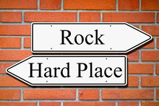
Tough Realities for Supervisors
Supervisors are the key intersection linking line staff and upper management.
Overleveraged
Targeted or blamed
Unrealistic expectations
Notes:
This Photo at https://www.publicdomainpictures.net/view-image.php?image=21451&&picture=stuck-between-a-rock-and-a-hard-place&&large=1
retrieved February 19, 2024, is licensed under https://creativecommons.org/publicdomain/zero/1.0/.

Slide 21
Your Spot in the System
Leadership
Management
Direct Staff
Custody and Operations
Leadership and Management
Programs and Treatment

Slide 22
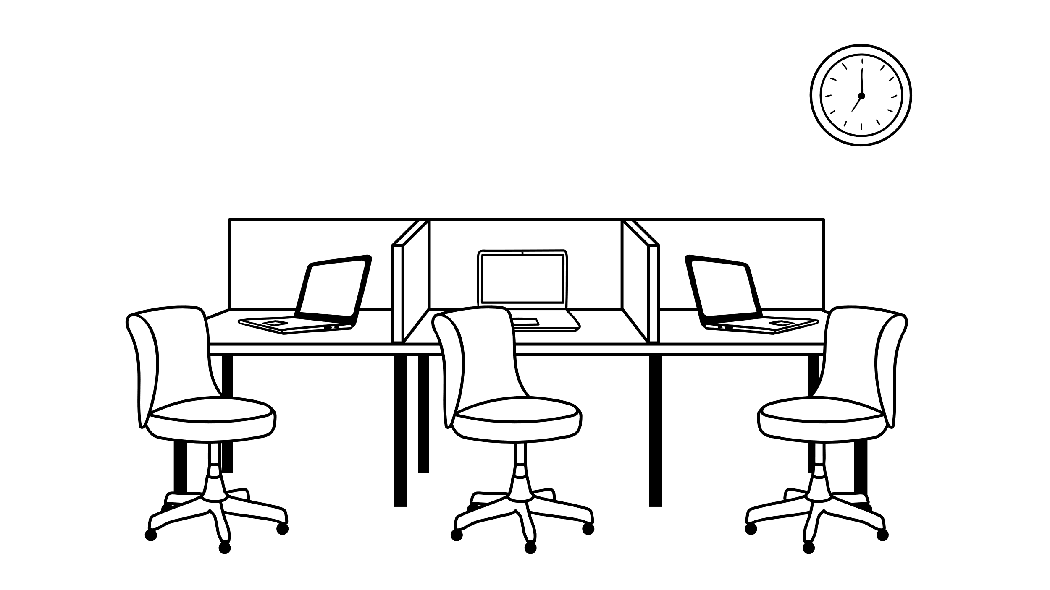
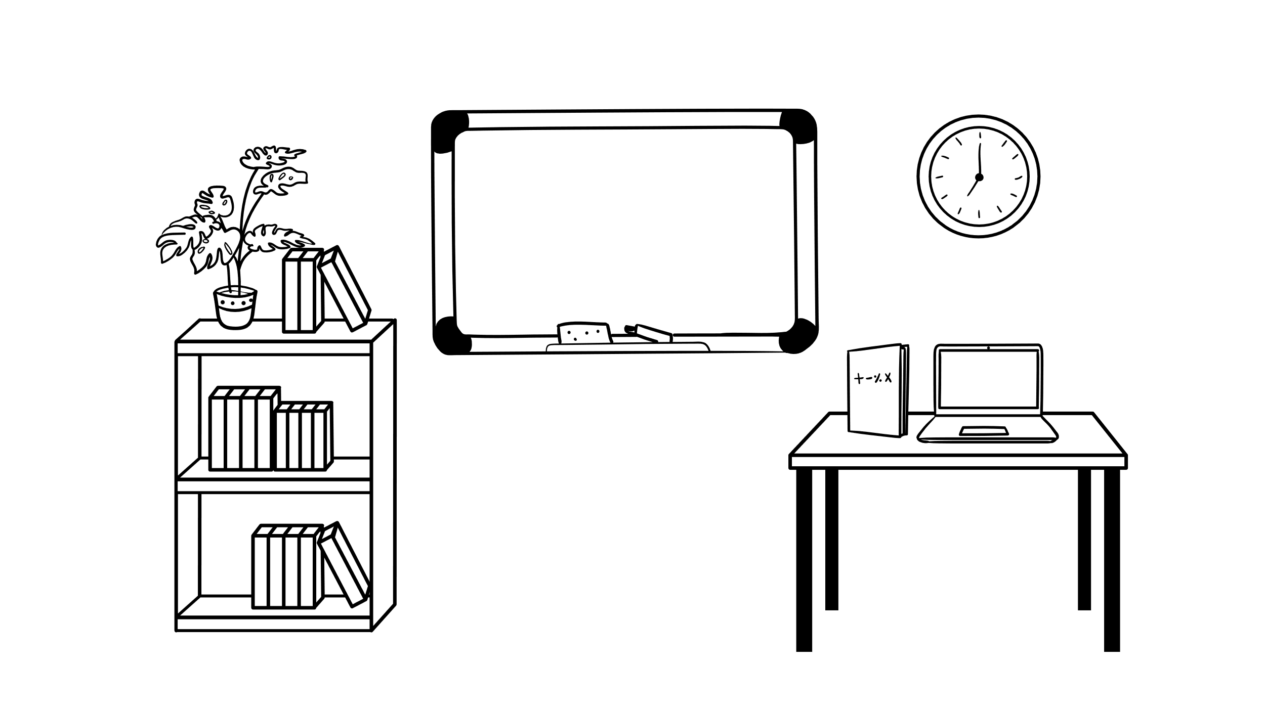
Silo Effect

Slide 23
Module 1 Wrap-up
Question 1
Question 2
Which of the below is NOT a characteristic of a healthy team?
Trust
Conflict
Mascot
Defined Roles
Leaders define what to do. Supervisors drive how it’s done.
Notes:
This photo (https://www.pngall.com/true-and-false-png/ by Unknown Author retrieved April 30, 2024 is licensed under https://creativecommons.org/licenses/by-nc/3.0/.

Slide 24
Alignment
Baselines and Boundaries
Disappointment
Communication
 | L | E | A | D | D
 | Listening | Empathy | Adaptability | Discretion | Discretion
AND
F | O | L | L | O |  | W
Up and Through

Slide 25
The Basics, Establishing Your Management Acumen
MODULE 2
Notes:
https://www.flickr.com/photos/aeioux/2209356512

Slide 26
Think Back.. Effective and Ineffective Supervisors
Notes:
https://pixabay.com/ko/%EC%8A%A4%EB%A7%88%EC%9D%BC-%EC%9D%B4%EB%AA%A8%ED%8B%B0%EC%BD%98-%EC%9B%83%
https://pixabay.com/en/emoji-face-emotions-sad-2792377/

Slide 27
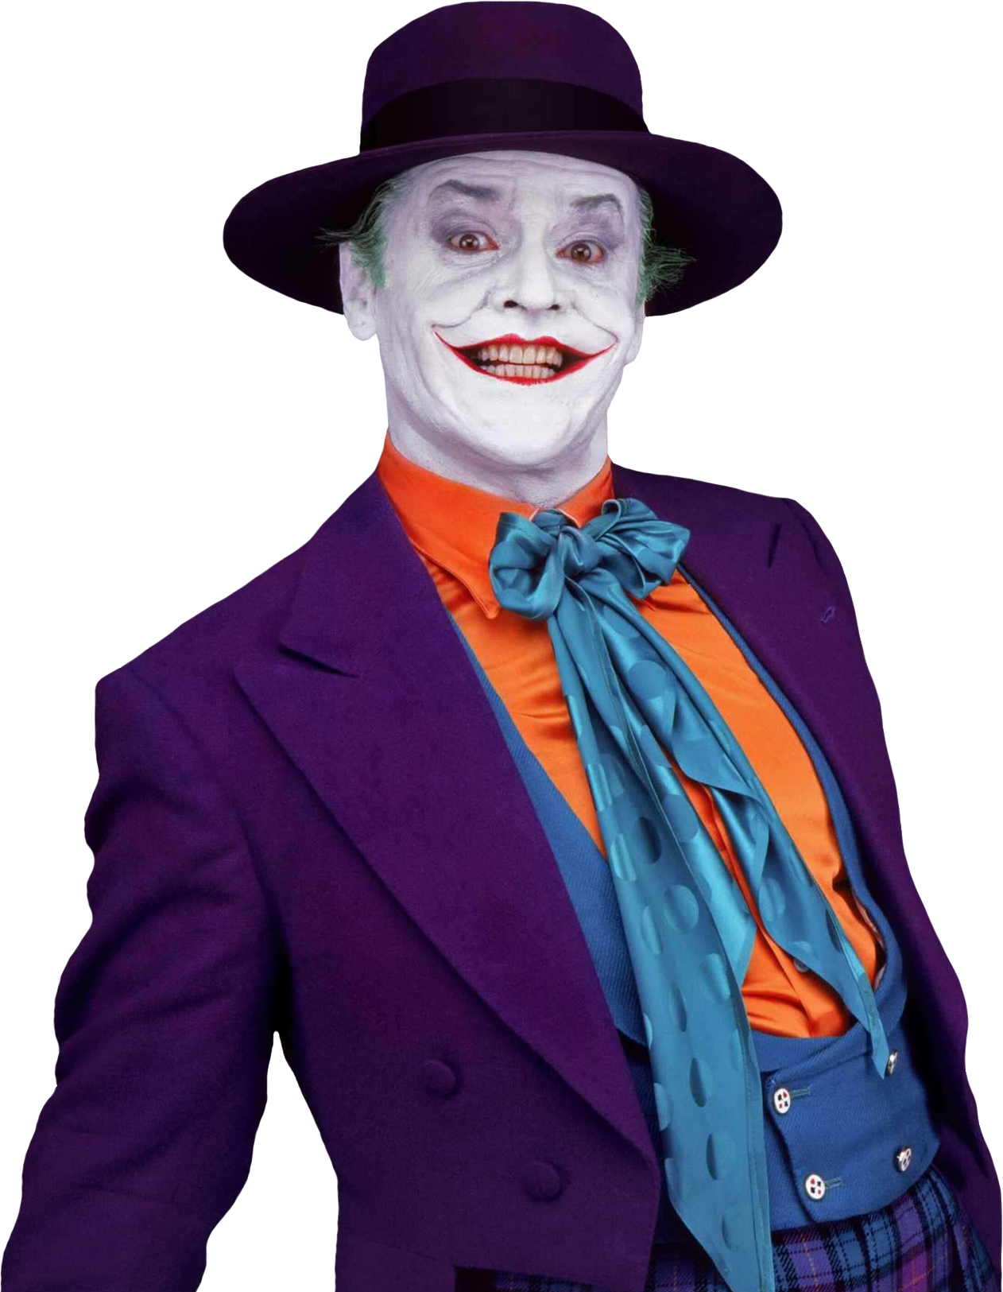
Who Played It Best?
Notes:
This Photo by Unknown Author is licensed under CC BY-NC
This Photo by Unknown Author is licensed under CC BY-SA-NC
This Photo by Unknown Author is licensed under CC BY-NC
This Photo by Unknown Author is licensed under CC BY-NC

Slide 28
Supervisor Acumen Styles
Authoritarian
Top-down, power, non-collaborative
Bureaucratic
Rules driven, policy, maintaining status quo
Democratic
Team driven, open to input, collaborative
Servant
Putting people first, sharing knowledge, flexible
Visionary
Growth focused, challenging to exceed
And many more!

Slide 29
Supervisor Style Factors
Independent
Risk Taking
Emotional
Tentative
Creative
Passive
Adaptive
Collaborative
Cautious
Pragmatic
Decisive
Routine
Ambitious
Resistant

Slide 30
Top 5 Correctional Supervisor Skills
Active Listening
Critical Thinking
Monitoring
Social Perceptiveness
Coordination

Slide 31
What are some concerns you have as a new supervisor?
Notes:
This Photo by Unknown Author is licensed under CC BY-SA

Slide 32
Tug of War
Be empathetic!
Don’t under-communicate!
Get the job done!
Advocate for staff!
Don’t overcommunicate!
Balance work and life!
Don’t get too personal!
Keep at a need-to-know!
Manage your time!
Enforce the rules!
Transparency is key!
The overtime is mandatory!
Notes:
Photo: https://www.publicdomainpictures.net/view-image.php?image=234645&&picture=pretahovani-lanem retrieved April 18, 2024 is licensed under https://creativecommons.org/publicdomain/zero/1.0/.
Photo: http://pixabay.com/en/stickman-stick-figure-matchstick-man-151356/ retrieved April 18, 2024 is free to use under the Content License Summary (pixabay.com).

Slide 33
Core Competencies
Alignment:
Baselines and Boundaries:
Disappointment:
Communication:
Walk the walk and talk the talk.
Know them, set them, and respect them.
It’s the key—Lead and Follow.
Let them down at an absorbable rate.

Slide 34
Familiarize yourself with policy and department expectations.
Model policy and hold others to the same standard as yourself.
Notes:
This Photo (https://pressbooks.bccampus.ca/esm1/chapter/chapter-1/) by Unknown Author Retrieved February 24, 2024 is licensed under https://creativecommons.org/licenses/by/4.0/.

Slide 35
Notes:
https://youtu.be/PTo9e3ILmms - video permission requested by SM on 04/15/2024
Permission to use received 04/15/2024.

Slide 36
What does performance and trust look like?

Slide 37
It Takes Time
Intentional and built over time
Result of your actions and character
Rooted in consistency and equitability
Cornerstone of culture
Notes:
This Photo by Unknown Author is licensed under CC BY-ND

Slide 38
What are baselines?
What are boundaries?
Involve our most basic attitudes, behaviors, and tendencies
Formed by our genetic makeup and unique experiences
Shape and influence how we perceive, interpret, and respond
Legal, ethical, and organizational framework
Guidelines, expectations, and rules to protect us all
Defines limits to prevent blurred or crossed lines
Separation of work and personal life

Slide 39
What are the benefits of having professional boundaries?
What are the risks of not having professional boundaries?
What types of attitudes or behaviors should you be looking out for? From yourself? Fellow supervisors? Your staff?

Slide 40
Red Flag Attitudes and Behaviors
Inconsistent enforcement of rules and policy
Distancing from staff—more aligned with the population
Doing work meant for someone else
Excessive time spent without reason
Not using vacation time
Notes:
This photo (https://commons.wikimedia.org/wiki/File:Red_flag_waving.svg) retrieved April 19, 2024 is licensed under https://creativecommons.org/licenses/by-sa/3.0/.

Slide 41
What concerns, if any, do you have about redefining your professional boundaries?

Slide 42
Boundaries With Former Peers
Reset the dynamic
Ask for discretion and patience
Address the elephant in the room
Notes:
This Photo https://www.deviantart.com/pepey/art/Elephant-in-the-room-747516645 by Unknown Author retrieved June 27, 2024 is licensed under https://creativecommons.org/licenses/by-nc-nd/3.0/

Slide 43
Small Group Activity
Get into small groups.
Review the questions in your manual.
Take a few minutes to discuss as a group.
Be prepared to report out on your responses.
Notes:
This photo (https://www.tuktukdesign.com/people-icon-01/) retrieved April 19, 2024 is licensed under https://creativecommons.org/licenses/by/3.0/.

Slide 44
Strategies to Support Boundaries
Get to know yourself
Get to know your staff
Recognize triggers
Engage healthy rechargers
Recognize red flags
Safe reporting culture

Slide 45
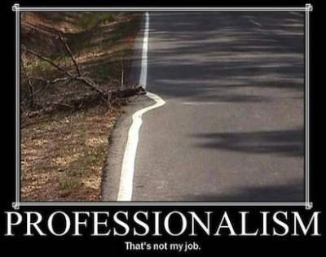
Model the Expectation
Redefine your boundaries based on new acumen styles required as a supervisor
Value self wellness
Manage workload—delegation and fairness
Model routine maintenance
Notes:
This photo (https://www.aliem.com/article-review-professionalism-in-ed/) retrieved April 19, 2024 is licensed under https://creativecommons.org/licenses/by-nc-nd/3.0/.

Slide 46
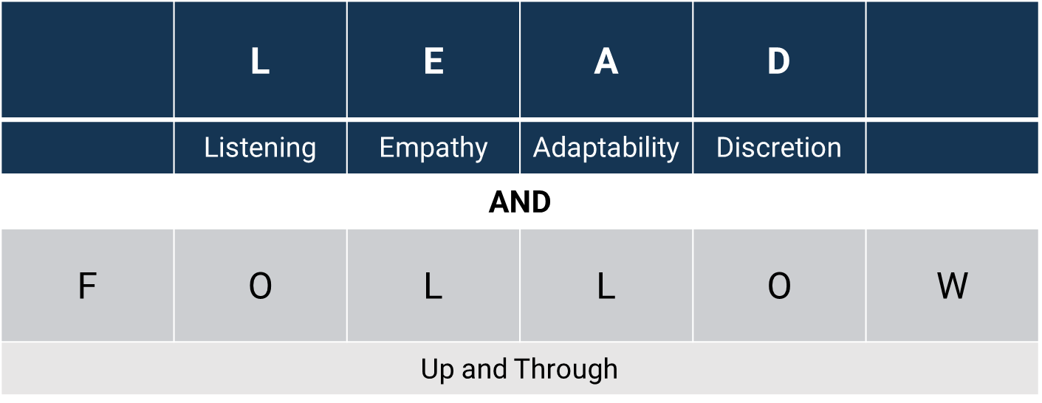

Slide 47
How might communication skills look different as a supervisor?
What communication skills do you see or hear about supervisors struggling with?

Slide 48
Communication Flow
Let’s talk about….
BEHAVIOR
…because..
WHY
…if….
OUTCOME
48
Notes:
This Photo by Unknown Author is licensed under CC BY-NC
This Photo by Unknown Author is licensed under CC BY-SA
This Photo by Unknown Author is licensed under CC BY-NC

Slide 49
Differing Viewpoints Activity
Get into triads.
Two will be assigned a viewpoint.
One will observe.
Take a minute and prepare your viewpoint.
Make your case.
Observers report out to class.
Notes:
https://pixabay.com/es/miembros-grupo-personas-equipo-42919/ retrieved April 22, 2024.

Slide 50
“Leadership is about disappointing people at the rate they can absorb.”
-Marty Linsky
Professor, Harvard University Kennedy School of Government
Cambridge Leadership Associates Co-founder

Slide 51
A Supervisor’s Truth
“If you’re a new manager, you probably feel a burning desire to be liked and accepted by your team…You want to win people’s approval, keep them happy, and demonstrate all the desirable attributes of a great boss. Even so, as the person in charge, almost everything you do will have the potential to trigger conflict… We constantly risk not being loved by the masses..” -Martin G. Moore

Slide 52
How can you manage disappointment at an absorbable rate?

Slide 53
Strategies for Disappointment
If you make a mistake, apologize.
Strive for balance between good and bad news.
Acknowledge that “fair” is often subjective.
Evaluate expectations.
Limit the spread.
Promote staff wellness and rechargers.

Slide 54
Module 2 Wrap-up

Slide 55
The skills: Strategies and Techniques Used by effective supervisors
MODULE 3
Notes:
This Photo by Unknown Author is licensed under CC BY-SA

Slide 56
Techniques and Skills for Effective Supervisors
 | L | E | A | D
 | Listening | Empathy | Adaptability | Discretion
AND
F | O | L | L | O | W
Up and Through

Slide 57
Listening
 | L | E | A | D
 | Listening | Empathy | Adaptability | Discretion
AND
F | O | L | L | O | W
Up and Through

Slide 58
Active Listening
Notes:
This Photo by Unknown Author is licensed under CC BY-SA-NC

Slide 59
Toss Game
Listening
Notes:
This Photo by Unknown Author is licensed under CC BY-SA: http://stackoverflow.com/questions/25766707/uiview-animating-a-2d-bouncing-ball-squash-stretch-in-ios

Slide 60
How do you know when someone is actively listening to you?

Slide 61
Active Listening Techniques
Ask questions, especially open-ended questions.
Paraphrase back what you’ve heard in your own words.
Use encouragers.
Replace judgment with curiosity.
Focus on the person speaking—nod and make eye contact.
Don’t think about how you might respond.

Slide 62
How else can you be an effective listener?
“I remind myself every morning: ‘Nothing I say this day will teach me anything. So, if I’m going to learn, I must do it by listening’.” Larry King

Slide 63
Effective Listening
Read the room
Know when to stop or start talking
Social cues
Consider the context
Group dynamics
Listening ratio

Slide 64
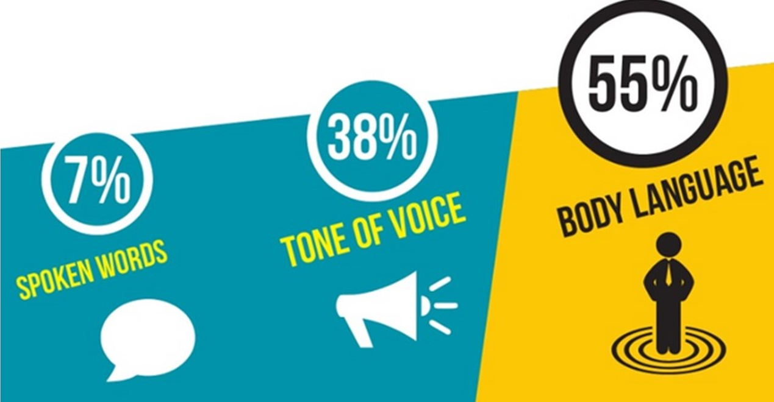
Message Detractors/Enhancers
Albert Mehrabian, Silent Messages.
Notes:
This Photo (https://pressbooks.senecacollege.ca/buscomm/chapter/unit-43-non-verbal-communication/) by Unknown Author retrieved February 12, 2024 is licensed under CC BY: https://creativecommons.org/licenses/by/3.0/

Slide 65
Tone Management: De-escalation
N Notice
Notice your own body language and tone of voice. Model the calm response you want from the other person.
O Offer
Offer reflective comments that show you are listening to what they say and how they feel.
W Wait
Wait for the other person to explain their position and release the emotion (within reason) before responding with solutions.

Slide 66
Addressing Tone
“I want to hear this and I’m having trouble understanding.
I see that you’re (insert demeanor).
Let’s start over so I know how to help.”

Slide 67
“This is ridiculous. Why is this so hard to understand? I have told you all so many times that I can’t do third shift. I have kids. Yet, I keep being scheduled on thirds. Who do I have to call to make this clear? Congress? I’m so tired of nobody listening to me.”
67

Slide 68
Body Language and Nonverbals
Posture
Eye contact
Hand gestures
Movement
Facial expression
68
Notes:
This photo (https://pressbooks.nscc.ca/buscomm/chapter/unit-43-non-verbal-communication/) by Unknown Author retrieved July 9, 2024 is licensed under https://creativecommons.org/licenses/by/3.0/.

Slide 69
Nonverbals Activity
Each group member pick an emotion slip.
One at a time express the emotion to the group using only nonverbals—body language and facial expressions.
Group guesses the emotion.
Notes:
This photo (https://www.thedoodlelibrary.com/mugs/guy-blankExcited) retrieved May 29, 2024 is licensed under https://creativecommons.org/licenses/by/3.0/.
This photo (https://www.thedoodlelibrary.com/mugs/gal-blank) retrieved May 29, 2024 is licensed under https://creativecommons.org/licenses/by/3.0/.

Slide 70
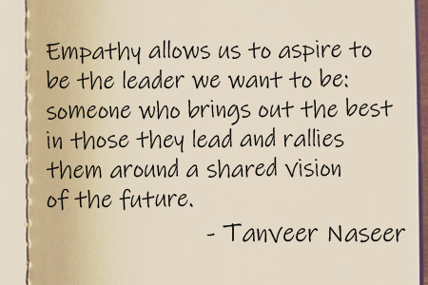
Notes:
This Photo by Unknown Author is licensed under CC BY-SA-NC
https://www.tanveernaseer.com/the-growing-importance-of-empathy-in-leadership-today/ retrieved April 24, 2024
https://creativecommons.org/licenses/by-nc-sa/3.0/

Slide 71
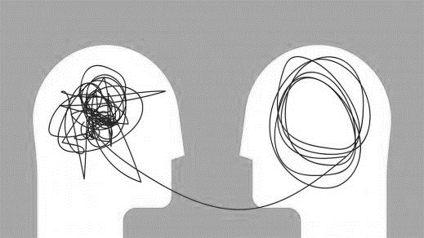
What Empathy Is Not
Problem solving
Weakness
Agreement
Sympathy
71
Notes:
This Photo by Unknown Author is licensed under CC BY-SA

Slide 72
“Gaslighting”
Notes:
This Photo (http://adaptistration.com/2019/04/03/taking-some-spin-out-of-the-chicago-rhetoric/) by Unknown Author retrieved April 26, 2024 is licensed under CC BY at https://creativecommons.org/licenses/by-nc-nd/3.0/.
This Photo (https://fortezzanascosta.wordpress.com/category/film/) retrieved April 26, 2024 is licensed under https://creativecommons.org/licenses/by-nc-nd/3.0/.

Slide 73
It’s All About Perspective
Notes:
This Photo by Unknown Author is licensed under CC BY-SA-NC

Slide 74
INTENT
.
IMPACT
VS.
74
Notes:
https://pixabay.com/en/fixed-birthday-gift-icon-button-2411132/
This Photo by Unknown Author is licensed under CC BY-NC

Slide 75
Listening for What Isn’t Said
Listen and observe for the underlying issue or emotion.
Trust your gut—if there’s more to it, ask questions.
Frequent stops or redirects to avoid emotion.
Repeating bland phrases—”know what I mean?” or “I don’t know..”

Slide 76
Empathy Scenario
A staff member asks to speak with you in your office and says the following:
“I’m in a bad place. My wife is sick and I… I don’t know. It’s hard. I haven’t gotten much sleep and am struggling to focus.”

Slide 77
Empathy Scenario
A staff member comes to you after a shift briefing and says the following:
“When is this going to stop. These new forms are going to take hours to fill out. This makes no sense! Does anyone in management remember what it’s like to work a unit?!”

Slide 78
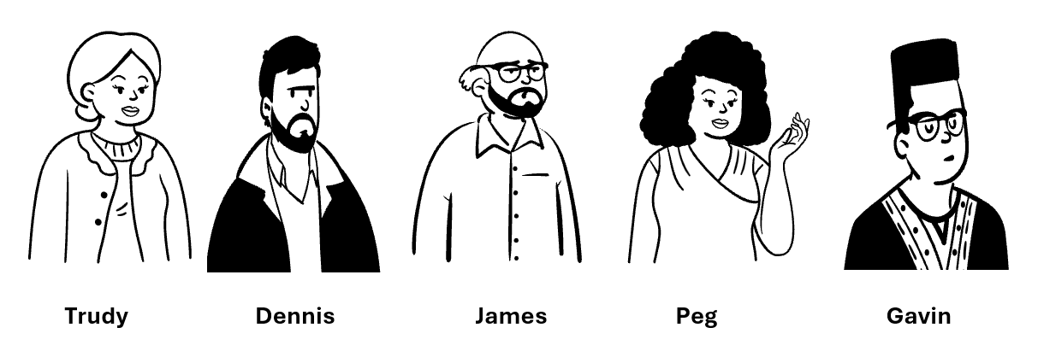
Let’s Apply Your Skills! Role Play Activity Tell Me About Yourself…

Slide 79
Round 1 Activity Instructions
Phase 1: Take 2 minutes to prepare for your role:
Staff member: Read the script.
Supervisor: Read the prompts for the upcoming interaction.
Observer: Review your goals for the interaction.
Phase 2: Take up to 5 minutes to conduct the role play.
Staff member and supervisor conduct role play.
Observers fill out form.
Phase 3: Take 5 to 6 minutes to debrief the interaction.
Observers facilitate discussion and provide feedback.

Slide 80
Round 1 Debrief
How did it go?
What concerns, if any, do you have with this staff member?
How were the empathetic responses?
Notes:
This Photo (https://juanamoral.blogspot.com/2014/03/a-job-interview.html) retrieved April 22, 2024 by Unknown Author is licensed under https://creativecommons.org/licenses/by/3.0/.

Slide 81
Notes:
This Photo by Unknown Author is licensed under CC BY

Slide 82
What does adaptability look like as a supervisor?

Slide 83
It is not the strongest of the species that survives, nor the most intelligent that survives. It is the one that is most adaptable to change.
-Charles Darwin
83

Slide 84
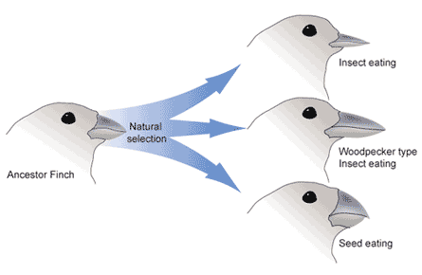
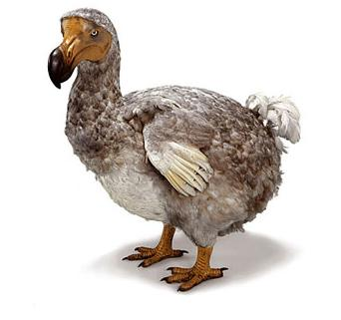
Adapt, Migrate, or Go Extinct
Notes:
Image from: https://pixabay.com/en/animals-birds-flying-geese-goose-2030018/
This Photo by Unknown Author is licensed under CC BY-SA
This Photo by Unknown Author is licensed under CC BY-SA

Slide 85
Building Resiliency
Resistance
Natural
Opportunity for improvement
Resilience
Learned
Self-preservation
Recovery
Recharge
Rest
Notes:
This Photo by Unknown Author is licensed under CC BY-SA-NC
This Photo by Unknown Author is licensed under CC BY-NC

Slide 86
Types of Change
Predictable
Planned
Welcomed
Unwelcomed
Unexpected

Slide 87
How have you seen people react to change at work?

Slide 88
Drivers of Change
Notes:
Photo (https://www.coursesidekick.com/management/study-guides/wmopen-organizationalbehavior/change-management) by Unknown Author retrieved April 19, 2024 is licensed under https://creativecommons.org/licenses/by/3.0/.

Slide 89
Case Study: McDonalds
First McDonald’s opened in 1940 in San Bernardino, California, by Richard and Maurice McDonald.
Opened as a full-service carhop barbeque joint using real plates and silverware with over 40 barbecue items.
Soon realized 80% of their sales were hamburgers.
Notes:
This Photo (https://www.angsarap.net/2012/12/10/barbecue-pork-ribs/) by Unknown Author retrieved April 30, 2024 is licensed under https://creativecommons.org/licenses/by/3.0/.

Slide 90
Case Study, cont.
In 1948, it closed for three months and rebranded as a hamburger self-service restaurant.
Fired 20 employees, switched to single-use containers and cups, and simplified to 9 items.
Used a 12-person crew who specialized in specific tasks.
Notes:
This Photo (https://arvindpariti.blogspot.com/2012/10/the-first-mcdonalds.html) by Unknown Author retrieved April 30,2024 is licensed under CC BY-SA: https://creativecommons.org/licenses/by/3.0/.

Slide 91
Case Study, cont.
In 1954, Ray Kroc, a milkshake mixer salesmen visited McDonalds that was using 8 of the mixers.
Kroc was intrigued by the business model and was hired in 1955 as the franchise agent.
Kroc bought the company from the brothers in 1961 for $2.7 million after years of arguments.
In 1955 there were 9 stores, by1963 there were 500 stores.
Today, there are over 36,000 franchises in over 100 countries.
Notes:
This Photo (https://www.wethementors.com/people/ray-kroc) by Unknown Author retrieved April 30, 2024 is licensed under https://creativecommons.org/licenses/by/3.0/.

Slide 92
Drivers of Change
Notes:
Photo (https://www.coursesidekick.com/management/study-guides/wmopen-organizationalbehavior/change-management) by Unknown Author retrieved April 19, 2024 is licensed under https://creativecommons.org/licenses/by/3.0/.

Slide 93
Case Study Activity
In small groups discuss the assigned topic:
Answer the questions on the worksheet.
Debrief the activity.
Advertising
Technology
Community
Competition
Labor
Cultural Influence
Menu
Missions
Notes:
This photo, from https://www.rawpixel.com/image/3801589/photo-image-blue-vintage-food, is licensed under https://creativecommons.org/publicdomain/zero/1.0/, retrieved July 25, 2024.

Slide 94
Mission Statements:
…to be our customers’ favorite place and way to eat and drink.
…to be our customer’s first choice when it comes to top quality products outstanding service, cleanliness, and great value for money.
…to feed and foster communities.
…to make delicious feel-good moments easy for everyone.
Notes:
This photo, from https://www.rawpixel.com/image/3801589/photo-image-blue-vintage-food, is licensed under https://creativecommons.org/publicdomain/zero/1.0/, retrieved July 25, 2024.

Slide 95
How can understanding drivers of change support you as a supervisor?

Slide 96
Managing Change
Firm, fair, and consistent
Help slow or prevent burnout
Anticipate needs and resistance
Support resilience and recovery time

Slide 97
Individual Activity
Your Captain informed you the facility is going to be installing new cameras and issuing body-worn cameras to staff. The cameras will be installed in the coming months and the body-worn cameras will arrive in the coming weeks. All staff will be required to wear them during their full shift. You’ve been instructed to make the announcement at shift briefing.

Slide 98
Notes:
This Photo by Unknown Author is licensed under CC BY-NC

Slide 99
What do you think about when you hear the term discretion?

Slide 101
Targeted Focus for Discretion
Time Management
Use of Authority
Conflict Management

Slide 102
Time Management
Be realistic
Do routine audits
Use scheduling aids
Delegate tasks
Honor breaks
Notes:
https://www.rawpixel.com/search/hourglass

Slide 103
The Eisenhower Matrix
Notes:
This photo (https://www.duperrin.com/english/2020/07/22/why-it-is-sometimes-necessary-to-refuse-to-tackle-a-problem/) retrieved July 8, 2024 by Unknown Author is licensed under https://creativecommons.org/licenses/by/3.0/

Slide 104
Authority vs. Power to Influence
Notes:
This Photo by Unknown Author is licensed under CC BY
This Photo by Unknown Author is licensed under CC BY-NC

Slide 105
Types of Power
Expertise
What you know
Network
Who you know
Rewards
What you can offer
Fear
What you can take away
Information/ Resources
What you can withhold or leverage
Charisma
How much you are liked
Longevity
How long you’ve been around
105

Slide 106
Promoting Your Influence
Get feedback
Reflect and apologize
Delegate
Acknowledge other’s gifts
Advocate and encourage
Promote work-life balance

Slide 107
Conflict Management Styles
Notes:
This photo (https://courses.lumenlearning.com/wm-organizationalbehavior/chapter/conflict-management-styles/ by Unknown Author retrieved April 6, 2024 is licensed by https://creativecommons.org/licenses/by/3.0/

Slide 108
Conflict Considerations
108

Slide 109
Addressing Staff Behavior
Let’s talk about….
BEHAVIOR
…because..
WHY
…if….
OUTCOME
109
Notes:
This Photo by Unknown Author is licensed under CC BY-NC
This Photo by Unknown Author is licensed under CC BY-SA
This Photo by Unknown Author is licensed under CC BY-NC

Slide 110
Let’s Apply Your Skills! Role Play Activity #2 Do You Have A Minute…

Slide 111
Round 2 Activity Instructions
Phase 1: Take 2 minutes to prepare for your role:
Staff member: Read the script.
Supervisor: Read the prompts for the upcoming interaction.
Observer: Review your goals for the interaction.
Phase 2: Take up to 5 minutes to conduct the role play.
Staff member and supervisor conduct role play.
Observers fill out form.
Phase 3: Take 5 to 6 minutes to debrief the interaction.
Observers facilitate discussion and provide feedback.

Slide 112
Round 2 Debrief
How did it go?
How were the core competencies used?
How were LEAD skills used?
Notes:
This Photo (https://juanamoral.blogspot.com/2014/03/a-job-interview.html) retrieved April 22, 2024 by Unknown Author is licensed under https://creativecommons.org/licenses/by/3.0/.

Slide 113
Let’s Apply Your Skills! Role Play Activity #3 We need to talk…

Slide 114
Round 3 Activity Instructions
Phase 1: Take 2 minutes to prepare for your role:
Staff member: Read the script.
Supervisor: Read the prompts for the upcoming interaction.
Observer: Review your goals for the interaction.
Phase 2: Take up to 5 minutes to conduct the role play.
Staff member and supervisor conduct role play.
Observers fill out form.
Phase 3: Take 5 to 6 minutes to debrief the interaction.
Observers facilitate discussion and provide feedback.

Slide 115
Round 3 Debrief
How did it go?
How were skills used?
How was resistance addressed?
How would you manage the change to staff?
Notes:
This Photo (https://juanamoral.blogspot.com/2014/03/a-job-interview.html) retrieved April 22, 2024 by Unknown Author is licensed under https://creativecommons.org/licenses/by/3.0/.

Slide 116
Module 3 Wrap-up
What are LEAD skills and techniques?
 | L | E | A | D
 | L | E | A | D
 | Listening | Empathy | Adaptability | Discretion

Slide 117
It’s all connected: cultivating growth and employee engagement
MODULE 4
Notes:
This Photo by Unknown Author is licensed under CC BY-SA-NC

Slide 118
Notes:
This Photo by Unknown Author is licensed under CC BY
This Photo by Unknown Author is licensed under CC BY-SA

Slide 119
FOLLOW UP IS…
FOLLOW THROUGH IS…
…creating further action.
Feedback
Feedforward
Performance Reviews
Coaching
…bringing to conclusion.
Creating Closure
Celebrating Wins
Keeping Promises
Showing Appreciation
Notes:
This Photo by Unknown Author is licensed under CC BY
This Photo by Unknown Author is licensed under CC BY-SA

Slide 120
How does follow-up and follow-through impact staff?

Slide 121
Effects of Follow-up and Through
Engagement
Retention
Growth
Notes:
This Photo by Unknown Author is licensed under CC BY

Slide 122
122

Slide 123
Supervising in Today’s Climate
“Post”-COVID era—changes in population
Law enforcement accountability movements
Use of technology– remote work limits to collaboration
Staffing shortages
Employee engagement and generational differences
And many more!
123

Slide 124
Employee Engagement
In 2016, 74 percent of employees were willing to support organizational changes, but dropped to 38 percent in 2022.
30 percent of new hires leave within 90 days because the role didn’t meet expectations (43%), a specific incident (34%), and culture (32%).
Highly engaged workplaces saw 41 percent lower absenteeism.
124

Slide 126
Employee Turnover
40% of workers report high employee turnover at their organization over the past year
58% of frontline/essential workers report working more in the past year because of high employee turnover (versus 28% of non-frontline workers)
This has led to an increase in stress levels and feelings of burnout in 78% of workers

Slide 127
Potential Signs of Burnout
Exhaustion
Loss of enthusiasm for work—reduced performance
Worry or anxiety
Changes to sleep and/or diet
Irritability and mood swings
Physical symptoms: headache, stomach issues, frequent illness

Slide 128
Burnout Indicators
Emotional Exhaustion
Intrinsic to the job
Relationships at work
Depersonalization
Stressors associated with the role
Organizational climate
Sense of Accomplishment
Role in the organization
Development and growth

Slide 129
How can you help support staff engagement?

Slide 130
Opportunities to Engage Staff
Performance reviews
On the job training
Shift briefings
Coaching
Feedback and Feedforward

Slide 131
Importance of Performance Reviews
Overlooked or underused
Undervalued
Foundational
Revolutionary
Notes:
This photo (http://change-meme.com/2016/02/09/improving-performance-reviews/) by Unknown Author retrieved May 1, 2024 is licensed under https://creativecommons.org/licenses/by/3.0/.

Slide 132
What has your experience been with performance reviews?

Slide 134
Limitations of Feedback and Performance Reviews
Timing
Limited data or interaction
Tied to salary and wages
Feel too formal and one-sided
Influenced by past experiences

Slide 135
Feedback
Feedforward
Focused on the past
Requires knowledge of what happened
Most often used to address what went wrong
Often associated with judgment
Effective for identifying behaviors to discontinue
Focused on the future
Seeks to understand goals and desired skills
Used to emphasize what is possible
Often associated with encouragement
Effective for identifying behaviors to grow

Slide 137
Collaborative Coaching
“Coaching requires managers to transition from the traditional role of controlling and monitoring employee performance to a more consultative role. Coaching is a means for developing a partnership between the manager and employee that creates a shared understanding about what needs to be achieved and how it is to be achieved.”
Alyce Johnson
MIT Human Resources
Notes:
This photo (http://www.peoplematters.in/article/training-development/abcs-of-sales-coaching-12884) retrieved May 2, 2024 is licensed underhttps://creativecommons.org/licenses/by-nc-sa/3.0/.

Slide 138
“When people feel like their voice is heard, their investment in their work increases far more than when they are being told what do and exactly how to do it.”
Notes:
This Photo by Unknown Author is licensed under CC BY-SA

Slide 139
Coaching is…
Coaching is not…
Motivating
Provides clarity
Improves performance
Empowering
Confidence building
Mentoring
Therapy
Fixing
Precluding accountability
Progressive discipline
Notes:
This photo (http://www.peoplematters.in/article/training-development/abcs-of-sales-coaching-12884) retrieved May 2, 2024 is licensed underhttps://creativecommons.org/licenses/by-nc-sa/3.0/.

Slide 140
Let’s Apply Your Skills! Role Play Activity #4 What’s next for you…

Slide 141
Round 4 Activity Instructions
Phase 1: Take 2 minutes to prepare for your role:
Staff member: Read the script.
Supervisor: Read the prompts for the upcoming interaction.
Observer: Review your goals for the interaction.
Phase 2: Take up to 5 minutes to conduct the role play.
Staff member and supervisor conduct role play.
Observers fill out form.
Phase 3: Take 5 to 6 minutes to debrief the interaction.
Observers facilitate discussion and provide feedback.

Slide 142
Round 4 Debrief
How did it go?
How were skills used?
How did it feel as the staff member?
How did it feel as the supervisor?
Notes:
This Photo (https://juanamoral.blogspot.com/2014/03/a-job-interview.html) retrieved April 22, 2024 by Unknown Author is licensed under https://creativecommons.org/licenses/by/3.0/.

Slide 143
Module 4 Wrap-up
Question 1
Question 2
Which of the following is NOT an effect of follow-up and follow through:
Retention
Technology
Engagement
Growth
Coaching is most effective when it is continuous.
Notes:
This photo (https://www.pngall.com/true-and-false-png/ by Unknown Author retrieved April 30, 2024 is licensed under https://creativecommons.org/licenses/by-nc/3.0/.

Slide 144
Index Card Activity
On the index card, write down your top three takeaways from this training.
In your manual, write down the first two or three things you will do to prepare for your next shift as a result of this training.
Notes:
This photo (https://openclipart.org/detail/140221).

Slide 145
Stay Connected!
Facebook: https://www.facebook.com/DOJBJA
X: https://x.com/DOJBJA
YouTube: https://www.youtube.com/dojbja
Use the QR code to subscribe to “Justice Matters” and “News From BJA” to receive the latest information from BJA and the field.
For information on funding opportunities, publications, and initiatives, visit BJA’s website: www.bja.ojp.gov.

Slide 146
Questions?

